Slide 1

Introduction to Linux
DevOps Essentials
2020

Slide 2
Environment Variables
Execution path
In BASH, execution of a program happens when you enter the program name. Your PATH variable keeps you from having to enter the full path to the program
Modifying your PATH
$ echo $PATH
$ PATH=$PATH:/data/$USER
$ echo $PATH
PATH set using above method is not persistent after reboot.
To path changes permanent, need to modify the .bashrcfile in your home directory or update /etc/environment.

Slide 3
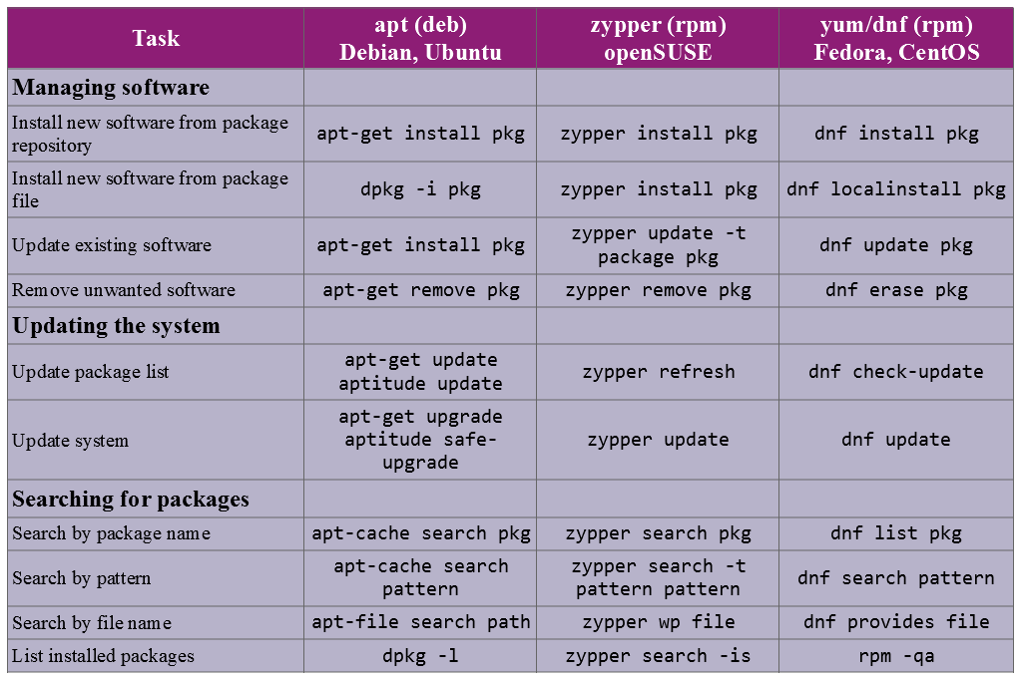
Package Management

Slide 4
Package Management : RPM
RPM Package Manager (RPM)
YUM and DNF are simply front-ends to a lower-level tool called RPM. The following commands should be run as root. The flags are expanded here, but the abbreviated syntax is also included:
rpm --install --verbose --hash local-rpm-file-name.rpm - Installs an rpm from the file. rpm is also capable of installing RPM files from http and ftp sources as well as local files.
rpm --erase package-name(s) - Removes the given package.
rpm --query --all - lists the name of all packages currently installed.
rpm --query package-name(s) - allows you to confirm whether a given package is installed in your system.
rpm --query --info package-name(s) - displays the information about an installed package.
rpm --query --list package-name(s) - generates a list of files installed by a given package. This is complemented by:
rpm --query --file - checks to see what installed package “owns” a given file.
Note that RPM does not automatically check for dependencies.

Slide 5
Package Management : dpkg
Debian Package Manager (DEB)
Apt-get and apt-cache are merely frontend programs that provide a more usable interface and connections to repositories for the underlying package management tools called dpkg.
dpkg -i package-file-name.deb - Installs a .deb file.
dpkg --list search-pattern - Lists packages currently installed on the system.
dpkg --configure package-name(s) - Runs a configuration interface to set up a package.
dpkg-reconfigure package-name(s) - Runs a configuration interface on an already installed package.
dpkg --purge --force-all package – Remove/ uninstall package.

Slide 6
Start and Stop services
systemctl commands
sudo systemctl [action] [service name]
service commands
sudo service [service name] [action]
To start a service:
sudo systemctl start ufw
sudo service ufw start
To stop a service:
sudo systemctl stop ufw
sudo service ufw stop
To restart a service:
sudo systemctl restart ufw
sudo service ufw restart
To check the status of service:
sudo systemctl status ufw
sudo service --status-all
Set service to start at boot:
sudo systemctl enable ufw
sudo chkconfig ufw on
Disable service to start at boot:
sudo systemctl disable ufw
sudo chkconfig ufw off

Slide 7
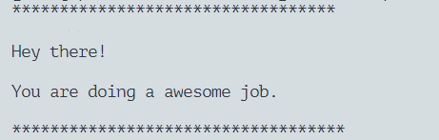
Lab 3
1. Install httpd using yum.
2. check status of httpd service.
3. Check httpd is running under which user using ps.
4. Download file index.html from below link, in your home directory.
http://3.93.79.170:9090/webfile.tar.gz
5. Extract that tar file. You will have one file called index.html
6. Next, copy that index.html to /var/www/html/ (You might be asked to overwrite an existing file, do that.)
7. Set ownership and permission on that file as per the permission of /var/www/html
8. Restart httpd service.
9. Check if your webserver is working or not with below command:
# curl http://localhost
Output should be like:
Note: If your webserver is having issue run below command and try again.
# setenforce 0

